Slide 1
CPSC 375 Introduction to Data Science and Big Data Analytics
Dr. Anand Panangadan
apanangadan@fullerton.edu

Slide 2
What we will cover today
Exploratory Data Analysis
In R

Slide 3
Exploratory Data Analysis (EDA)
First step to building a model
Data-driven (model-free)
Goal: get a general sense of the data
Getting your hands “dirty” with the data
Interactive and visual
Humans are good at pattern recognition

Slide 4
Why EDA?
To gain intuition about the data
Sanity checking
Is the data as expected?
Are the ranges of variables as expected?
detect outliers (e.g. assess data quality)
test assumptions (e.g. normal distributions or skewed?)
identify useful raw data & transforms (e.g. log(x))
Is there missing data?
What is the scale of the data?
Is it Big Data?

Slide 5
The Data Science Process
Data Visualization
Data analysis
Exploratory Data Analysis
Formatting, Cleaning
Data integration
Storage
Data

Slide 6
Exploratory Data Analysis (EDA)
Systematically going through the data
Generating summary statistics
Evaluating data quality
Visualizing each variable
Visualizing all pairwise relationships

Slide 7
Summary Statistics
not visual
sample statistics of data X
mean
median
quartiles of sorted X: Q1 value = X_{0.25n} , Q3 value = X_{0.75 n}
interquartile range: value(Q3) - value(Q1)
IQR()
Variance
mode: most common value in X
summary(iris)

Slide 8
Data quality
Is there missing data?
Count the NAs
Possible that missing values are not stored as NA
Instead, 0 or -1 or something that cannot be a valid value
Are there outliers?
Check for each variable

Slide 9
Some special values
NA: Not Available (placeholder for a missing value).
NULL: empty value
Inf: Infinity
is.na(), is.null() and is.infinite()
to identify missing, empty and infinite values in data
complete.cases() to identify the rows in a data frame that are complete (no missing values)
Many functions give NA if any of the inputs is NA
E.g.: mean(x)
Give parameter na.rm=TRUE to remove the NAs in the input
E.g.: mean(x, na.rm=TRUE)
Notes:
max(c(1,2,NA,5))
max(c(1,2,Inf,5))
max(c(1,2,NA,5), na.rm = TRUE)
str(airquality)
is.na(airquality$Ozone)
which(!complete.cases(airquality))
which(is.na(airquality), arr.ind = TRUE)

Slide 10
Numerical vs Categorical Variables
Numerical variables
Values can be ordered, i.e., there is a natural ordering between the values
E.g., Age (younger/old), Weight (lighter/heavier)
Can calculate averages
Also called Ordinal variables
Categorical variables
There is no natural ordering between the values
E.g., Marital status: Single, Married, Divorced
E.g., Color: red, blue, green, …
E.g., Species: iris$Species: setosa, versicolor, virginica
Cannot called averages
Also called Nominal variables

Slide 11
Single Variable Visualization
Numerical variable:
Histogram
Box plot
Categorical variable:
Bar graph

Slide 12
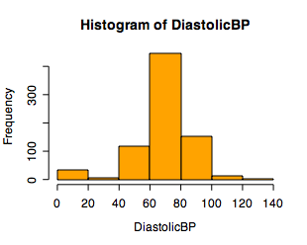
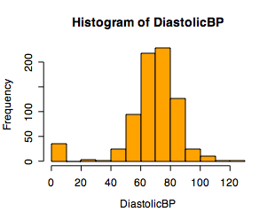
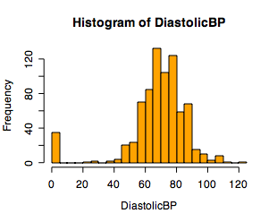
Single Variable Visualization
Histogram:
Shows center, variability, skewness, modality, outliers, or strange patterns.
Bin width and position matter
Beware of real zeros

Slide 13
R code
ggplot(data=airquality)+geom_histogram(mapping = aes(x=Ozone))

Slide 14
Issues with Histograms
For small data sets, histograms can be misleading.
Small changes in the data, bins, or anchor can deceive
For large data sets, histograms can be quite effective at illustrating general properties of the distribution.
Histograms only work with one variable at a time

Slide 15
Classwork
Consider the data iris
Create a histogram of Petal.Length
Try different values of binwidth
Save final plot as a PNG file and add it to your Google Doc

Slide 16
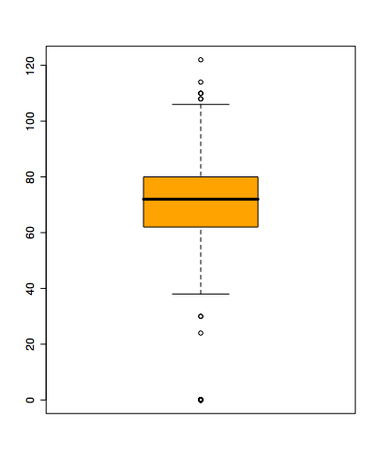
Boxplots
Shows a lot of information about a variable in one plot
Median
Inter-quartile range (IQR)
Outliers
Range
Skewness
Negatives
Overplotting
Hard to tell shape of distribution
no standard implementation in software (many options for whiskers, outliers)
“Hinges”
“Whiskers”
Outliers
Notes:
Horizontal line in box is median (Q2)
Top and bottom of plot are always Q1 and Q3
Whiskers can mean several things: usually these are the minimum and maximum of all of the data
Values outside this range are pkptted as outliers (circles)

Slide 17
Making Boxplots
A boxplot is a graphical display of the five-number summary

Slide 18
The Five-Number Summary
Median (50% value)
Quartiles
1st and 3rd quartiles: 25% and 75% values
Extremes: maximum and minimum of the expected valid points
Statistic | Value
Max | 8.67
Q3 | 2.93
Median | 1.90
Q1 | 1.15
Min | 0.20

Slide 19
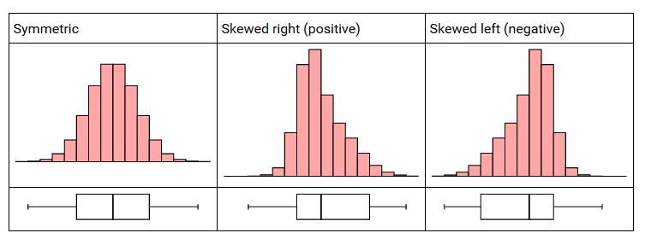
Skewness

Slide 20
Identifying Outliers
In addition to serving as a measure of spread, the interquartile range (IQR) is used as part of a rule of thumb for identifying outliers.
The 1.5 x IQR Rule for Outliers
Call an observation an outlier if it falls more than 1.5 x IQR above the third quartile or below the first quartile.
Interquartile range (IQR) = 0.75 quantile – 0.25 quantile
Only a rule of thumb – not every identified data point is an outlier

Slide 21
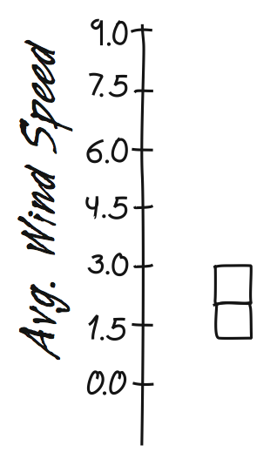
Constructing Boxplots
Draw a single vertical axis spanning the range of the data
Mark the median
Draw “hinges” at the lower and upper quartiles
Then connect them with vertical lines to form the “box”

Slide 22
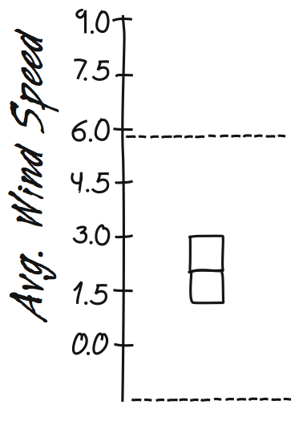
Constructing Boxplots (cont.)
Draw “fences” around the main part of the data.
The upper fence is 1.5*(IQR) above the upper quartile.
The lower fence is 1.5*(IQR) below the lower quartile.
Note: the fences only help with constructing the boxplot and should not appear in the final display.

Slide 23
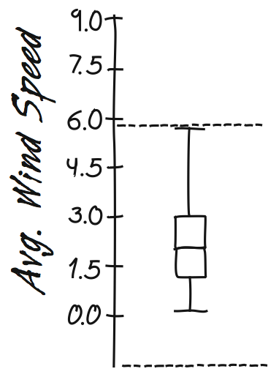
Constructing Boxplots (cont.)
Use the fences to grow “whiskers.”
Draw lines from the ends of the box up and down to the most extreme data values found within the fences.
If a data value falls outside one of the fences, we do not connect it with a whisker.

Slide 24
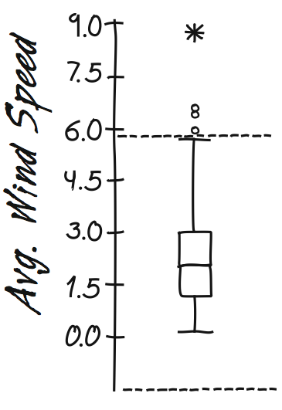
Constructing Boxplots (cont.)
Add the outliers by displaying any data values beyond the fences with special symbols.
We often use a different symbol for “far outliers” that are farther than 3 IQRs from the quartiles.

Slide 25
Demonstration
Construct a boxplot of 9 values:
36, 42, 100, 28, 17, 12, 9, 4, 1
Notes:
36 42 100 28 17 12 9 4 1

Slide 26
Boxplot in ggplot
geom_boxplot()
Hinges are at the 25% and 75% quartiles
The upper whisker extends from the hinge to the highest value that is within 1.5 * IQR of the hinge
The lower whisker extends from the hinge to the lowest value within 1.5 * IQR of the hinge.
Data beyond the end of the whiskers are outliers and plotted as points

Slide 27
Boxplots of iris variables
ggplot(data=iris) + geom_boxplot(mapping=aes(y=Sepal.Width))

Slide 28
Classwork
Construct a boxplot of the Ozone column in the airquality dataset
Create the boxplot using ggplot
Save plot as PNG file
Verify that outliers match what you get using the IQR “rule-of-thumb”
Hint: use IQR() and quantile() functions

Slide 29
Classwork
Construct a boxplot of these 9 values
8,11,17,36,25,24,1,20,64
Create the boxplot using ggplot
Save plot as PNG file

Slide 30
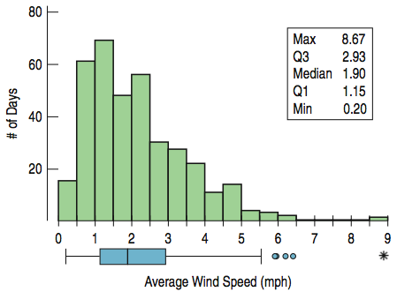
Boxplots vs Histograms

Slide 31
Classwork
Explore the airquality dataset
How many variables, size of the data, …
Is this Big Data?
Summary statistics
Is there missing data? Which variables are most affected?
Visualize each variable individually
Are there outliers?
Store results in a Google Doc on the shared folder
Should any variable(s) be converted to a factor?
Which ones?

Slide 32
Pairs of Variables Visualization
It is almost always more interesting to compare groups
Two numerical variables:
Scatterplot
One numerical variable, one categorical variable
Box plot
Two categorical variables
Bar graph

Slide 33
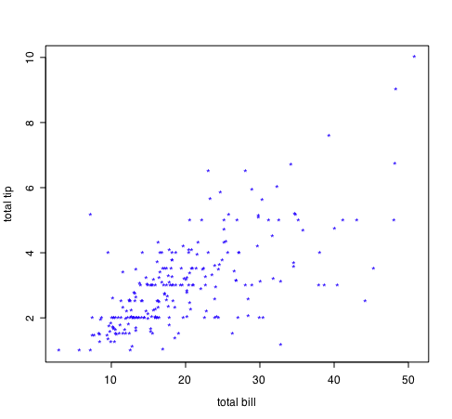
Two Numerical Variables
For two numeric variables, the scatterplot is the obvious choice

Slide 34
Scatterplots
standard tool to display relation between 2 variables
e.g. y-axis = response, x-axis = suspected indicator
Questions to answer:
x,y related?
linear
quadratic
other
variance(y) depend on x?
outliers present?
outliers?

Slide 35
Scatterplots of iris variables
Is there a relationship between variables?

Slide 36
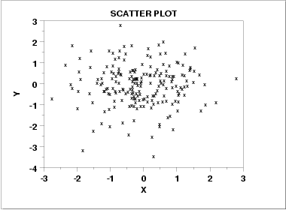
Scatter Plot: No apparent relationship

Slide 37
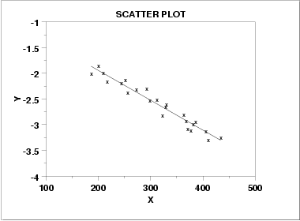
Scatter Plot: Linear relationship

Slide 38
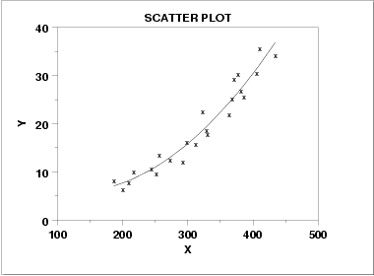
Scatter Plot: Quadratic relationship

Slide 39
One numerical variable, one categorical variable
ggplot(data=iris) + geom_boxplot(mapping=aes(y=Sepal.Width, x=Species))
Categorical variable
Factor in R
Takes one of a small set of values
Box plot
x-axis is categorical variable
y-axis is numerical

Slide 40
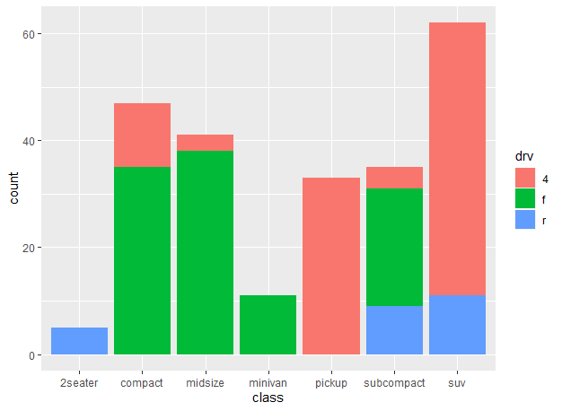
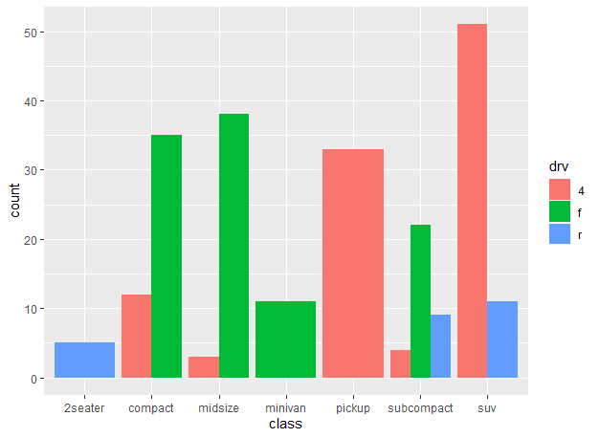
Two categorical variables
Stacked/dodged bar graph
> ggplot(data=mpg)+ geom_bar(mapping = aes(x=class, fill=drv))
> ggplot(data=mpg)+ geom_bar(mapping = aes(x=class, fill=drv), position = "dodge")

Slide 41
Classwork
Explore the airquality dataset
How many variables, size of the data, …
Is this Big Data?
Summary statistics
Is there missing data? Which variables are most affected?
Visualize each variable individually
Are there outliers?
Should any variable(s) be converted to a factor?
Which ones?
Convert these to a factor
Visualize any 5 pairs of variables of the airquality dataset
Choose the appropriate plot for each pair
Store work in a Google Doc on the shared folder

Slide 42
Classwork (contd.)

Slide 43
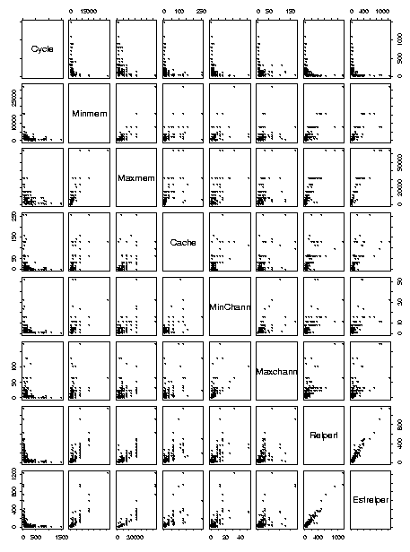
More than two variables
Pairwise scatterplots

Slide 44
Summary Statistics
Summarize numerical variable values
mean, median, …
apply() function in R
apply(data, dimension, function)
Dimension:
1: rows
2: cols
Function:
Mean
median

Slide 45
Generate summary statistics of iris variables
mean(iris) # doesn’t work
apply(iris, 2, mean) # doesn’t work
apply(iris[,1:4], 2, mean)

